Slide 1
Disaster Search AGENT
MINI PROJECT
Submitted By:
T C Dharshan – 2023006380
Sameer - 2023004759

Slide 2
Problem Statement
Natural disasters such as floods, earthquakes, and fires cause severe damage to life and property, making rescue operations highly challenging. One of the major difficulties faced during such situations is the quick identification and location of survivors in complex and hazardous environments. Traditional search and rescue methods rely heavily on manual efforts, which are time-consuming, risky, and often inefficient in large-scale disaster scenarios.
Therefore, there is a need for an intelligent and automated system that can assist rescue teams by quickly analyzing disaster scenes and identifying survivors. An AI-based Disaster Search Agent can help detect human presence and understand the disaster context from images, enabling faster decision-making and improving the overall efficiency and effectiveness of rescue operations.

Slide 3
Objectives
Detect survivors in disaster images
Identify disaster type (flood, fire, etc.)
Use YOLO for accurate object detection
Provide visual and numerical output
Assist rescue teams with faster decision-making

Slide 4
Algorithms, Techniques and Tools
Algorithm: YOLO (You Only Look Once) is used for real-time object detection. It identifies objects such as people (survivors), boats, and other elements in disaster images with high speed and accuracy.
Techniques: The system uses Computer Vision and Deep Learning techniques for image analysis and object detection. It also applies object-based reasoning to determine the type of disaster based on detected objects.
Tools: Python is used as the programming language. YOLOv8 (Ultralytics) is used for object detection. OpenCV is used for image processing and displaying results. VS Code is used as the development environment.

Slide 5
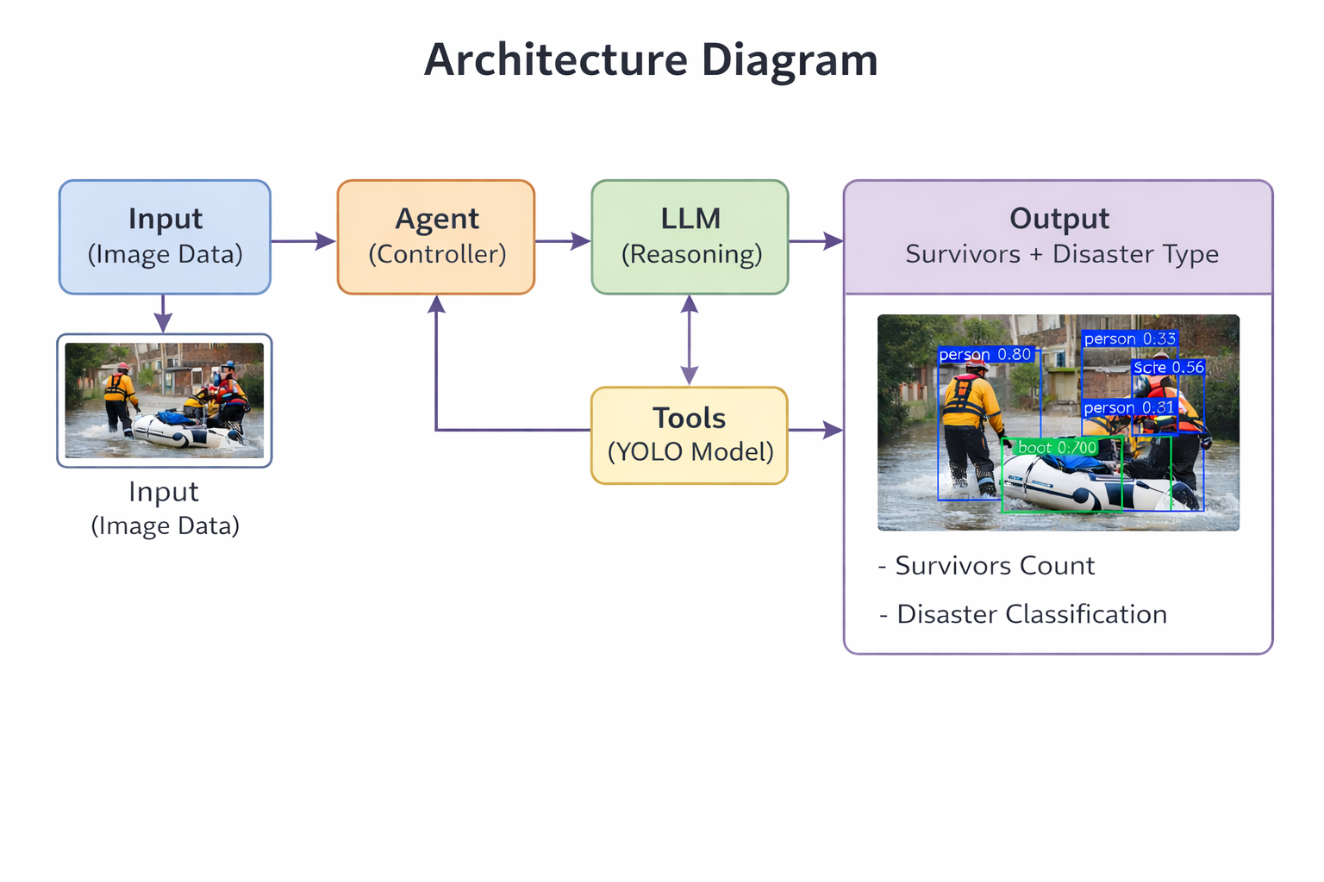
Design Strategy

Slide 6
Implementation
Input Acquisition:
The system receives a disaster image as input from the user.
2. Image Processing: The input image is loaded and prepared for analysis.
3. Model Initialization: The YOLO model is loaded for object detection.
4. Object Detection: The image is passed to the YOLO model to detect objects such as people, boats, etc.
5. Bounding Box Generation: Bounding boxes with labels and confidence scores are drawn around detected objects.
6. Survivor Detection: Objects labeled as "person" are identified and counted as survivors.

Slide 7
7. Data Collection: All detected object labels are stored for further analysis.
8. Disaster Analysis: The system applies rule-based logic:
Boat detected → Flood
Fire detected → Fire
Multiple people → Rescue/Flood scenario
9. Result Generation: The system determines the disaster type and total number of survivors.
10. Output Display: The final output is shown with annotated image, disaster type, and survivor count.

Slide 8
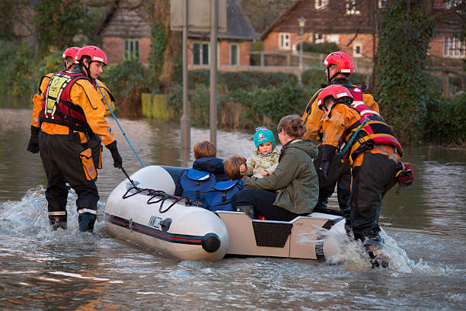
Result
The developed Disaster Search Agent successfully analyzed the input disaster image and detected multiple objects using the YOLO model. It accurately identified people in the image and counted a total of 7 survivors. The system also detected a boat, which helped in identifying the disaster as a flood situation. The final output included an annotated image with bounding boxes around detected objects along with the number of survivors and the predicted disaster type. Overall, the system provided fast and effective results even in a complex disaster environment.
Figure: Input image

Slide 9
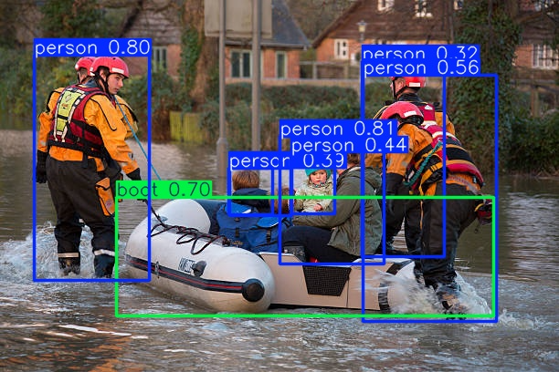
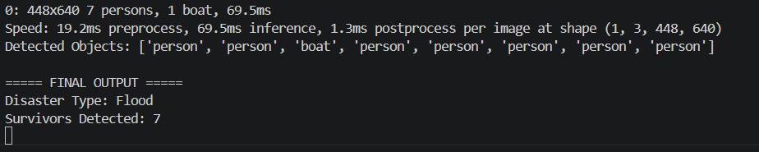
Figure: Detection of Survivors and Objects in Scenario
Figure: Final Output Showing Disaster Type and Survivor Count

Slide 10
Conclusion
The proposed Disaster Search Agent successfully detects survivors and identifies disaster types using AI and computer vision techniques. The YOLO model enables fast and accurate object detection, making the system effective in analyzing complex disaster scenes.
Detects survivors accurately using YOLO
Identifies disaster type (e.g., flood)
Provides quick and reliable results
Helps reduce manual effort in rescue operations

Slide 11


